Slide 1
Dosage calculation #3
NUR3260

Slide 2
Weight based medications
Many medications are prescribed by weight – especially in pediatric population
  Basing medications on weight ensures correct dosages

Slide 3
Mg/kg/day
Some prescriptions may be written as milligrams per kilogram of body weight per day
We then need to determine how many milligrams of a medication the client can have per day based on their weight in kilograms
Order states: Administer 20mg/kg/day
Client weighs 112lbs
How many milligrams can they have per day?
1) need to convert 112lbs to kg
112lb/2.2 = 50.9kg
2) Take mg x kg
20mg x 50.9kg
= 1,018mg/day
OR
112lb
1 kg
20mg
2240
=
= 1,018mg/day
2.2lb
1kg
2.2lb

Slide 4
Single doses
prescription should then indicate how many doses the client will receive throughout the day
Most often every 4, 6, 8 , or 12 hours (q4, q6, etc...)
Divide total daily by how many times a day client will receive...so:
  Q4 = 6 times a day (24 hours divided by every 4 hours = 6)
  Q6 = 4 times a day
  Q8 = 3 times a day
  Q12 = 2 times a day
So example from last slide = 1,018mg/day
How many mg would be delivered per dose if ordered Q6? What about Q12? Round to nearest whole number
Q6 = 1,018/4 = 255mg
Q12 = 1,018/2 = 509mg
If doing dimensional analysis you can add this into the equation:
- add 1 day over 24 hours and ___ hours over 1dose

Slide 5
Practice
Provider orders Tobramycin 4mg/kg/day to be administered every 8 hours
Client weighs 60kg
Available: Tobramycin 40mg/2ml
How many ml should the nurse give per dose? (round to whole number)
60kg
4mg
2ml
1 day
8 hour
=
3840
960
= 4ml
1kg
40mg
24 hours
1 dose
OR
240mg
4mgx 60 = 240mg per day
X 2ml
= 12ml per day
12 / 3 =
4ml per dose
40mg

Slide 6
More practice
Order states: administer lorazepam 0.05mg/kg one time before surgery.
Client weighs 192lbs
Available: Lorazepam 2mg/ml
How many ml will the nurse administer? Round to nearest whole number
192lb | 1kg | 0.05mg | 1ml | 9.6
 | 2.2lb | 1kg | 2mg | 4.4
=
= 2.09 = 2 ml
OR
192/2.2 = 87.272727 kg
4.363636 | x1ml | = 2ml
2
0.05 x 87.272727 kg = 4.363636mg

Slide 7
Weight based practice
You have on hand hydromorphone (Dilaudid) 4 mg/mL. You need to administer 0.015 mg/kg to a patient who weighs 150 pounds. How many milliliters should you administer? Record your answer using two decimal places.
1)
150lbs
68.2kg x 0.015mg/kg
= 68.2kg
2)
= 1.023 mg
2.2
3)
1.023mg
1mL
= 0.26mL
4mg
150lb
1kg
0.015mg
1mL
2.25
OR
= 0.255 = 0.26mL
2.2lb
1kg
4mg
8.8

Slide 8
CONSIDERATIONS
What needs to be in prescription
  Date and time prescription written
  Client’s full name
  Name of medication
  Indication (reason)
  Dose: amount times or frequency of administration and strength
  Route of admin
  Any specific instructions (ex. Take with food or without)
  Signature
Abbreviations to avoid:
  QD – once daily but looks like QID (4 times daily)
  HS – could mean bedtime or half-strength
  DC – could mean discharge or discontinue
What would you do if you have a prescription missing a piece or with one of the above abbreviations?

Slide 9
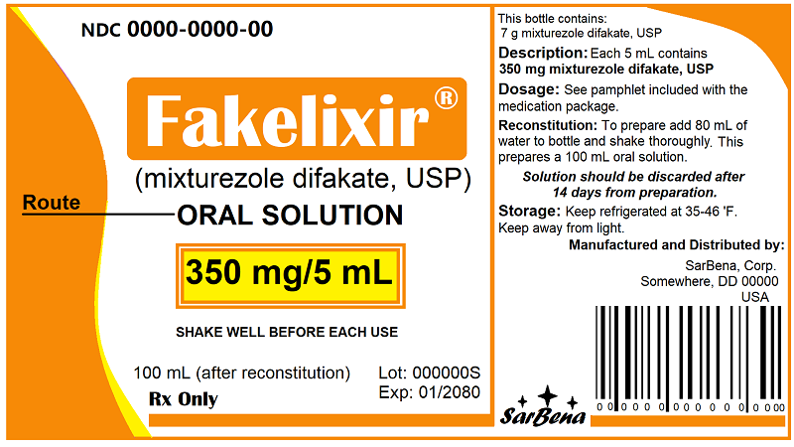
Reading a medication package

Slide 10
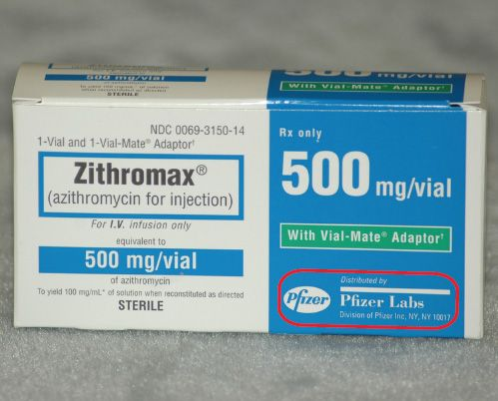
Reading packaging

Slide 11

Questions?

